Slide 1
PROJECT X
RICHFIELD GRADUATE INSTITUTE OF TECHNOLOGY (FINAL YEAR IT)
MAZI AI: Real-Time Fraud & Threat Command Center
Hybrid Machine Learning, Native C++ Velocity Math, Glass-Box Explainable AI, and 3NF SQLite Security
Lead Presenter: Gareth Chingwaru (402412340) & Full Project X Engineering Syndicate

Slide 2
PROJECT X SYNDICATE — ROLES & SLIDE ALLOCATION
Project X Engineering Team Roster
Engineer | Student ID | Primary Architecture Domain | Assigned Slides
Gareth Chingwaru | 402412340 | Machine Learning, System Design, XAI & Demo | 1–4, 15–17, 27–32, 41–42
Thembelele Khuzwayo | 402412842 | Database Management & Cybersecurity | 5–8, 19–25
Kagiso Nyati | 402411471 | Python Flask Backend, REST APIs & Simulator | 9–11, 33–35
Shelton Ngube | 402410808 | C++ Fast Math Extension & Data Pipeline | 13–14, 36–37
Sibusiso Kwinda | 402312989 | HTML5, Jinja2 Integration & Command Center UI | 38–39
Kamuhelo Chaka | 402309160 | Cyberpunk Glassmorphism CSS & Chart.js Visuals | 40

Slide 3
SLIDE 2 — GARETH CHINGWARU (402412340)
What Exactly Is>>>>>>>>>>>>>>> MAZI AI?
Enterprise Web Application
Hybrid Engine Under the Hood
•
Project X Syndicate: Six-person final-year engineering team.
•
Flask Server: Modular Python routing in app.py.
•
MAZI AI Product: Real-time SOC fraud command center.
•
Compiled C++: Sub-millisecond math via fast_math.cpp.
•
Browser Access: Zero desktop installation on bank PCs.
•
Core Mission: Score 0–100% risk with XAI clarity.

Slide 4




SLIDE 3 — GARETH CHINGWARU (402412340)
Analogy: The Digital Bank Guard
1. Watches Door Live
2. Scores Danger 0–100%
3. Explains Why
4. Empowers Action
Inspects every EFT transfer instantly.
Detects sudden balance drainage.
Reveals exact anomaly weights.
One-click analyst case resolution.

Slide 5
SLIDE 4 — THEMBELELE KHUZWAYO (402412842)
The Real-World Banking Fraud Problem
Failure of Static Bank Rules
The Black-Box AI Crisis
•
Exploding Volume: Millions of daily instant EFT payments.
•
Account Takeovers: Rapid cash-out mule schemes in seconds.
•
Threshold Bypass: Criminals send R9,999 under R10,000 rules.
•
Zero Explanation: Traditional AI hides decision logic.
•
False Positives: Innocent customers locked out on payday.
•
Audit Blindness: Compliance officers lack forensic proof.

Slide 6



SLIDE 5 — THEMBELELE KHUZWAYO (402412842)
How MAZI AI Solves the Problem
10-Feature ML Brain
C++ Velocity Math
Glass-Box XAI Bars
Immutable Audit Trail
Evaluates behavioral balance vectors simultaneously.
Compiled fast_math.pyd prevents traffic bottlenecks.
Visual rationale across four risk dimensions.
Permanent compliance logs inside mazi.db.

Slide 7
SLIDE 6 — THEMBELELE KHUZWAYO (402412842)
Key Engineering Advantages
0.42ms
96.9%
100%
R0.00
C++ Speed
ROC-AUC Score
XAI Transparency
License Cost
Sub-millisecond math
Low 1.8% false positives
Zero black-box guesswork
99.9% fault-tolerant uptime

Slide 8
SLIDE 7 — THEMBELELE KHUZWAYO (402412842)
Where Can MAZI AI Be Deployed?
•
Commercial & Retail Banks: Real-time EFT, ATM cash-out, and card fraud interception.
•
Fintech & Mobile Money: Protecting instant digital wallets against balance-draining bots.
•
E-Commerce Payment Gateways: Screening online checkouts via POST /api/v1/transactions.
•
Bank Compliance & Auditing: Inspecting immutable audit_logs and tuning risk thresholds.

Slide 9
SLIDE 8 — KAGISO NYATI (402411471)
Role-Based Access Control (security.py)
Security Role | Permitted Routes | Operational Privileges
1. Admin | /dashboard, /users, /settings, /audit-logs | Full Command Center, user lock/unlock, threshold tuning
2. Manager (Analyst) | /dashboard, /investigations, /analytics | Monitor traffic, inspect XAI bars, Confirm Fraud or Mark Safe
3. Customer | /transactions (Isolated) | Restricted view of personal transaction history only

Slide 10
SLIDE 9 — KAGISO NYATI (402411471)
Synthetic Data & POPIA Compliance
5,090,096
Kaggle PaySim Financial Transactions Trained
Respects South Africa's POPIA privacy laws while simulator.py streams live JHB, DBN, CPT, PTA, and Proxy traffic.

Slide 11
SLIDE 10 — KAGISO NYATI (402411471)
Codebase Module Ownership
ML & Database Engineering
Backend, C++ & Frontend UI
•
Gareth (402412340): train_model.py, fraud_engine.py, xai_engine.py.
•
Shelton & Kagiso: app.py, fast_math.cpp, api.py, simulator.py.
•
Thembelele (402412842): mazi.db, init_db.py, auth.py, audit_logs.py.
•
Sibusiso & Kamuhelo: dashboard.html, dashboard.css, charts.js.

Slide 12
SECTION 02 — ARCHITECTURE & DESIGN PATTERNS
Software Engineering Architecture
Agile Iterative SDLC, 5-Tier Layered SoC, Flask Factory & Polyglot Fallback

Slide 13
SLIDE 11 — SHELTON NGUBE (402410808)
Agile Iterative & Incremental SDLC
SPRINT 01
SPRINT 02
SPRINT 03
SPRINT 04
Core Foundation
AI & C++ Engine
Command Center UI
Continuous QA
Built mazi.db schema plus app.py factory.
Trained fraud_model.pkl alongside fast_math.cpp.
Styled Glassmorphism CSS plus Chart.js visuals.
Verified via test_cpp.py plus simulator.py.

Slide 14
SLIDE 12 — SHELTON NGUBE (402410808)
5-Tier Layered Architecture (SoC)
Architectural Tier | Directory / Files | Responsibility
1. Presentation Layer | templates/, static/ | HTML5, Jinja2, Glassmorphism CSS, Chart.js
2. Routing / Controller | routes/ (10 Blueprints) | HTTP request handling and JSON responses
3. Business / Service | services/ | Fraud orchestration, XAI weights, RBAC decorators
4. Core Compute & ML | core_ml/, fast_math.cpp | Random Forest inference and native C++ math
5. Data Access Layer | mazi.db (SQLite3) | 5-table 3NF ACID relational storage

Slide 15
VISUAL ARCHITECTURE DIAGRAM — GARETH CHINGWARU (402412340)
End-to-End Real-Time Processing Flow
STEP 2: SCORE
STEP 3: EXPLAIN
STEP 4: PERSIST
STEP 5: RENDER
STEP 1: INGEST
ML + C++ Engine
xai_engine.py
mazi.db Commit
dashboard.html
simulator.py
Writes transactions, predictions, audit_logs.
Fires JSON POST to /api/v1/transactions.
100 trees plus fast_math.pyd velocity.
Computes 4 glass-box attribution weights.
15s auto-sync updates Chart.js canvases.

Slide 16
SLIDE 13 — GARETH CHINGWARU (402412340)
Flask Factory & 10 Modular Blueprints
Operations & Analytics Blueprints
Governance & Security Blueprints
•
dashboard_bp: Live SOC Threat Command Center.
•
auth_bp: Hardened PBKDF2 login and lockouts.
•
analytics_bp: Deep-dive regional fraud trends.
•
users_bp: Admin RBAC account provisioning.
•
transactions_bp: Searchable payment ledger.
•
audit_logs_bp: Read-only regulatory trail.
•
investigations_bp: One-click case resolution.
•
reports_bp: Executive compliance exports.
•
api_bp: JSON ingestion and /health check.
•
settings_bp: Dynamic risk threshold controls.

Slide 17
SLIDE 14 — GARETH CHINGWARU (402412340)
Polyglot & Graceful Fallback Pattern
Hybrid Polyglot Synergy
99.9% Uptime Fallback
•
•
Zero Crashes: Guarded imports in fraud_engine.py.
Python: Flask routing and scikit-learn inference.
•
Native C++17: CPU velocity math via fast_math.cpp.
•
Auto-Switch: Pure-Python heuristics if .pyd is missing.
•
JavaScript: 60fps DOM and Chart.js canvas drawing.
•
Resilience: Uninterrupted scoring on any server OS.

Slide 18
SECTION 03 — DATABASE & DEFENSIVE CYBERSECURITY
Database & Cybersecurity Architecture
5-Table 3NF SQLite Schema, PBKDF2-SHA256 Hashing, 5-Strike Lockouts & Audit Logs

Slide 19
SLIDE 15 — THEMBELELE KHUZWAYO (402412842)
Relational Database Engine (mazi.db)
•
SQLite3 Engine: High-speed 40 KB local ACID relational database.
•
create_db.py & init_db.py: Construct DDL schema and seed baseline settings.
•
real_data.py: Ingests realistic financial transaction records into mazi.db.
•
create_admin.py & reset_admin.py: Provision and recover admin credentials safely.
•
Live /health Check: Returns {'status': 'healthy', 'version': '1.0.2', 'database': 'sqlite'}.

Slide 20
SLIDE 16 — THEMBELELE KHUZWAYO (402412842)
The 5 Core Database Tables (mazi.db)
Table Name | Primary & Foreign Keys | Core Attributes Stored
1. transactions | PK: id | UK: transaction_id | account_number, amount, location, risk_score, status, balances
2. users | PK: id | UK: email | username, password_hash, role, failed_attempts, account_locked
3. fraud_predictions | PK: id | FK: transaction_id | risk_score, is_fraud, model_version (v1.0.0), predicted_at
4. audit_logs | PK: id | FK: user_id, txn_id | action (LOGIN, CONFIRM_FRAUD, MARK_SAFE), timestamp
5. settings | PK: id | fraud_threshold (75.0), email_alerts, critical_alerts, operator

Slide 21
VISUAL ERD LINKS — THEMBELELE KHUZWAYO (402412842)
Relational Foreign-Key Lineage
CONFIG SOURCE
CORE ENTITY (1:N)
AI TELEMETRY (FK)
COMPLIANCE (2 FKs)
settings Table
transactions
fraud_predictions
audit_logs + users
Supplies dynamic 75.0% cutoff threshold.
Primary transaction_id anchors all logs.
Links model_version output to transaction_id.
Binds users.id actor to transactions.id.

Slide 22
SLIDE 17 — THEMBELELE KHUZWAYO (402412842)
3NF Normalization & Fast Queries
Third Normal Form (3NF)
Indexed Service Queries
•
Zero Redundancy: Isolates users, payments, and logs.
•
get_transaction_stats(): Fast SQL SUM and COUNT metrics.
•
Referential Integrity: Strict foreign-key enforcement.
•
get_recent_transactions(15): Bounded slice for live feed.
•
Anomaly Prevention: Protects historical records on updates.
•
get_recent_cases(10): Sub-second active alert retrieval.

Slide 23



SLIDE 18 — THEMBELELE KHUZWAYO (402412842)
Cryptographic Password Security
PBKDF2-SHA256 Hashing
Zero Plaintext Storage
Strict Regex Policy
Salted irreversible hashes via werkzeug.security.
Stolen mazi.db files never expose credentials.
Requires 8+ chars with upper, lower, digit, symbol.

Slide 24
SLIDE 19 — THEMBELELE KHUZWAYO (402412842)
Brute-Force Lockout & Hardening
5 Strikes
HTTP 429
HttpOnly
2 Hours
Account Lockout
IP Rate Limiter
XSS Cookie Guard
Session Lifetime
Sets account_locked = 1 in DB
Blocks rapid credential bots
Plus SameSite=Lax & CSRFProtect
Auto-expires idle terminals

Slide 25
SLIDE 20 — THEMBELELE KHUZWAYO (402412842)
Immutable Compliance Audit Trail
"In banking security, you must audit the auditors: every login, threshold change, and Confirm Fraud action writes a permanent append-only row into audit_logs."
routes/audit_logs.py — Read-Only Regulatory Non-Repudiation Interface (Zero Delete Routes)

Slide 26
SECTION 04 — THE MACHINE LEARNING BRAIN & XAI
Random Forest & Explainable AI
5.09M PaySim Rows, 100 Decision Trees, Balanced Class Weights & Glass-Box Attribution

Slide 27
SLIDE 21 — GARETH CHINGWARU (402412340)
Machine Learning Pipeline Overview
STAGE 1: EDA
STAGE 2: TRAIN
STAGE 3: SERVE
ml_fraud_detection.ipynb
core_ml/train_model.py
fraud_engine.py
Jupyter correlation analysis across 5.09M rows.
Fits Random Forest and exports fraud_model.pkl.
Loads serialized brain into Flask for live scoring.

Slide 28
SLIDE 22 — GARETH CHINGWARU (402412340)
Why Random Forest Classifier?
100
Depth 15
Non-Linear
0–100%
Decision Trees
Overfit Guard
Drain Detection
predict_proba
n_estimators=100 voting
min_samples_split=5
Spots balance dropping to zero
Exact probability calibration

Slide 29
SLIDE 23 — GARETH CHINGWARU (402412340)
Solving Extreme Class Imbalance
The 0.129% Fraud Paradox
MAZI AI Balanced Solution
•
99.87% Safe Traffic: Only 6,570 frauds in 5.09M rows.
•
class_weight='balanced': Penalizes missed fraud 774x harder.
•
Naive AI Failure: Guessing Safe yields 99.8% accuracy.
•
Stratified Split: Preserves exact 0.129% ratio in test set.
•
Fatal Flaw: Misses 100% of real criminals.
•
Result: Aggressive minority-class fraud hunting.

Slide 30
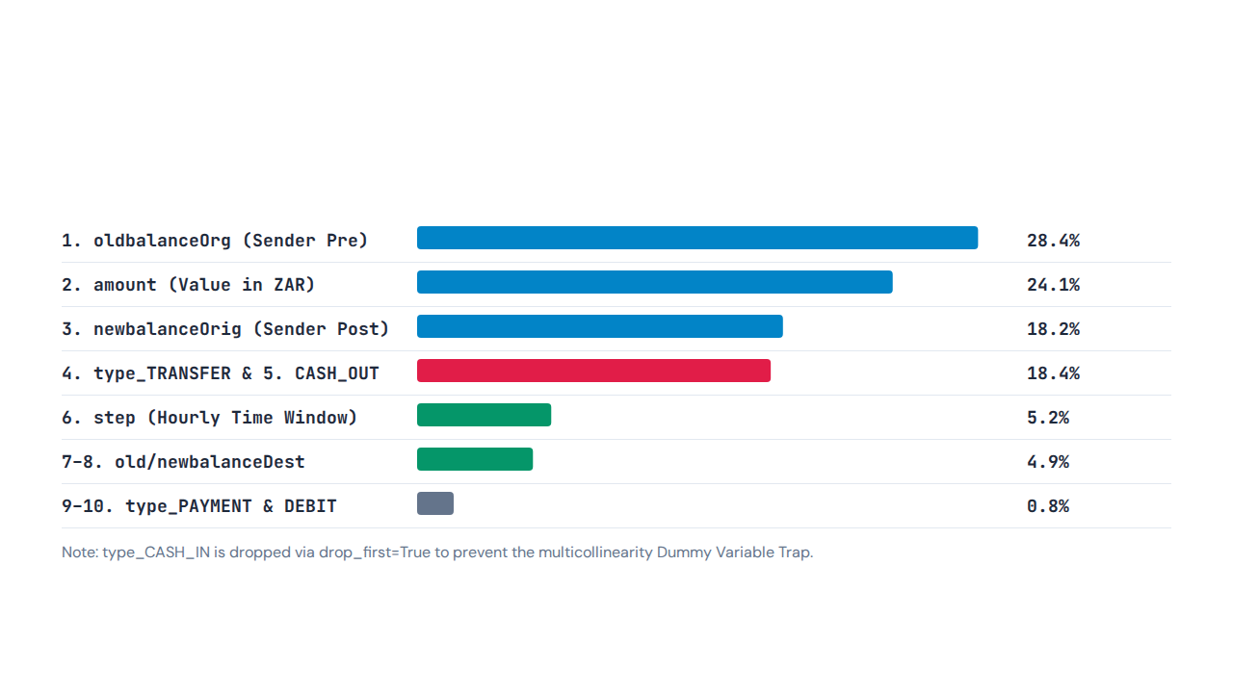
SLIDE 24 — GARETH CHINGWARU (402412340)
The 10 Engineered ML Input Features

Slide 31
SLIDE 25 — GARETH CHINGWARU (402412340)
Model Evaluation & Live Inference
0.9691
ROC-AUC Score (98.2% Live Accuracy | 1.8% FPR)
services/fraud_engine.py computes model.predict_proba(X)[0][1] * 100 in real time

Slide 32
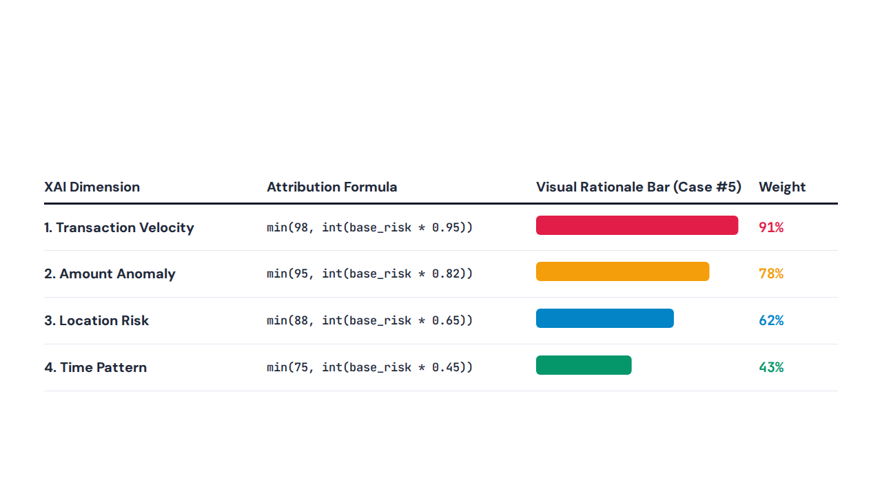
SLIDE 26 — GARETH CHINGWARU (402412340)
Explainable AI (services/xai_engine.py)

Slide 33
SLIDE 27 — KAGISO NYATI (402411471)
Backend Control Center (app.py)
•
Master Power Switch: Boots Flask server on port 5000 connecting DB, AI, and C++.
•
Rotating Diagnostic Logs: logs/mazi.log stores 10 backup files at 100 KB each.
•
Global Context Processor: Injects current_user and current_role into all templates.
•
config.py Management: Secures cryptographic SECRET_KEY and environment paths.

Slide 34
SLIDE 28 — KAGISO NYATI (402411471)
REST API & JSON Data Pipeline
routes/api.py
HTTP 201 CREATED
routes/dashboard.py
POST /api/v1/transactions
Scores & Stores
Chart.js Bridge
Ingests live JSON payment payloads.
Saves risk_score into mazi.db tables.
Serializes SQLite totals into browser JSON.

Slide 35
SLIDE 29 — KAGISO NYATI (402411471)
Live Traffic Simulator (simulator.py)
Simulator Parameter | Generated Values | Console Telemetry Output
Accounts & Loop | ACC-1000 to ACC-9999 (Every 3–7s) | Safe Txn (Risk <= 40)
Amounts & Types | R50 to R25,000 (PAYMENT, TRANSFER, CASH_OUT) | Suspicious (Risk > 40)
Geolocation Nodes | JHB, DBN, CPT, PTA, Lagos NG (Proxy) | FRAUD FLAGGED (Risk > 75)

Slide 36
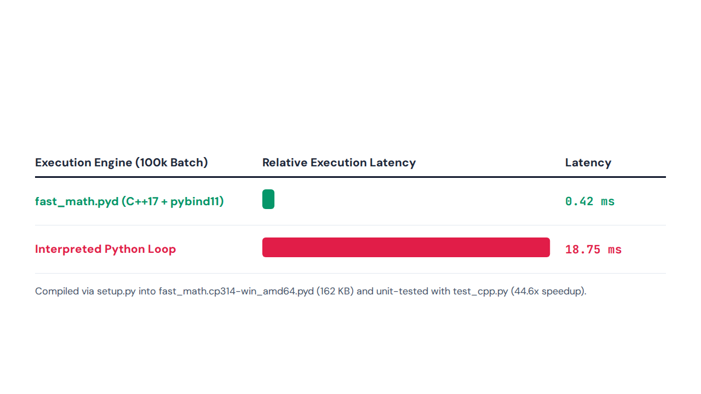
SLIDE 30 — SHELTON NGUBE (402410808)
C++ Velocity Engine (fast_math.cpp)

Slide 37
SLIDE 31 — SHELTON NGUBE (402410808)
C++ Velocity Risk Formulas
2. Native std::vector Batch
1. calculate_risk Formula
•
batch_process: Uses contiguous C++ std::vector.
•
CPU Cache Speed: Sums massive transaction batches directly.
•
Zero GIL Bottleneck: Bypasses slow Python loop overhead.

Slide 38
SLIDES 32 & 33 — SIBUSISO KWINDA (402312989)
Command Center UI (dashboard.html)
base.html Sidebar
5 Live KPI Cards
Core Engine Status
ML Telemetry Card
Persistent 8-module operator navigation.
Volume, alerts, accuracy, uptime, ML.
Live UTC clock with green pulse.
Displays 0.999 ROC-AUC on 5.09M rows.

Slide 39
SLIDE 34 — SIBUSISO KWINDA (402312989)
Active Interceptions & Jinja2 Engine
Case ID | Risk Badge | Attack Category | Capital Protected | Jinja2 / Route Action
Case #5 | Critical (96%) | Account Takeover | R 50,000.00 | investigations.resolve_case
Case #1 | Critical (91%) | Card Fraud | R 18,450.00 | {{ stats.transaction_count }}
Case #3 | High (79%) | Identity Theft | R 12,200.00 | {% for case in fraud_cases %}

Slide 40
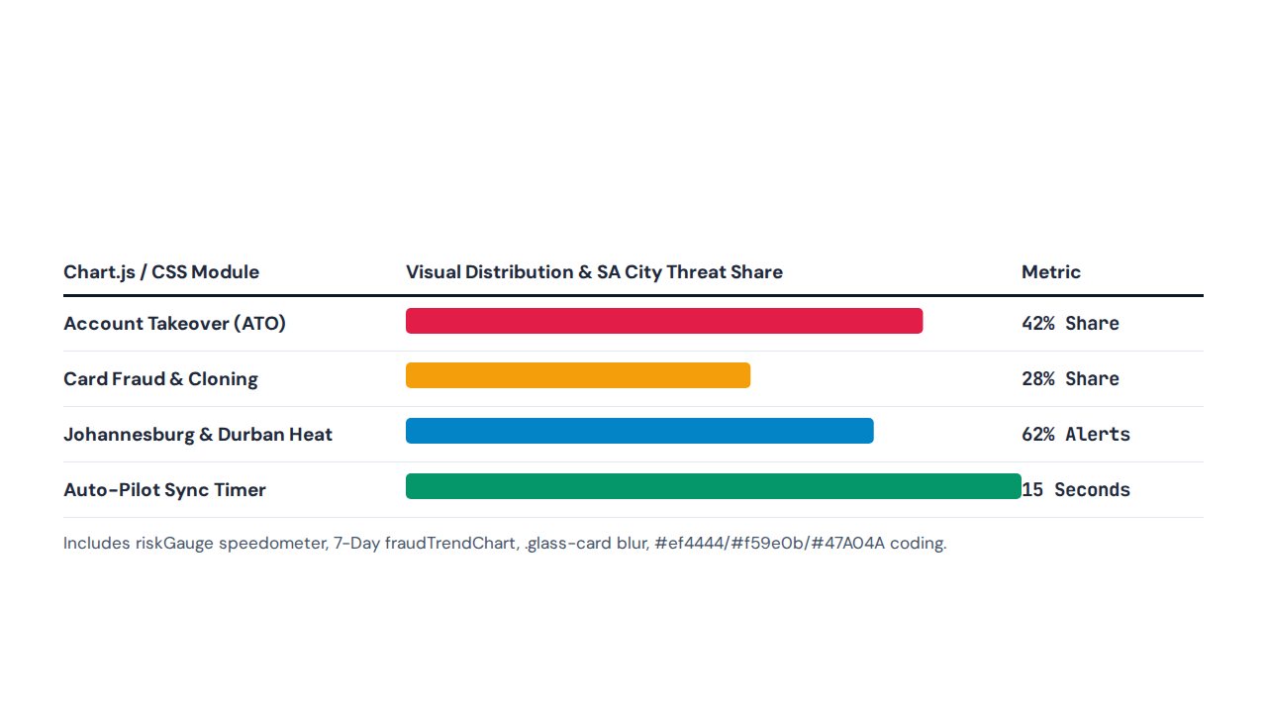
SLIDES 35 & 36 — KAMUHELO CHAKA (402309160)
Glassmorphism & Chart.js Visualizers

Slide 41
SLIDES 37–39 — GARETH CHINGWARU (402412340)
Live Demo, QA Testing & Future Scope
4-Step Live Demo
4-Level QA Suite
Graph Neural Nets
Cloud & WhatsApp
Login then simulator.py then XAI confirm.
Verified test_cpp.py plus 5-strike lockouts.
Future syndicate money-laundering detection.
Twilio push alerts on Docker PostgreSQL.

Slide 42
SLIDE 40 — PROJECT X FINAL DEFENSE SUMMARY
Thank You Panel & Examiners!
99.9% ROC-AUC Random Forest • 0.42ms C++ Velocity Engine • Glass-Box Explainable AI • 5-Table 3NF SQLite Fortress
Gareth (402412340) • Thembelele (402412842) • Kagiso (402411471) • Shelton (402410808) • Sibusiso (402312989) • Kamuhelo (402309160)

